Slide 1
Diagrams
By Simanga Mchunu
ALX-PROJECT-NEXUS
BACKEND-PRO

Slide 2
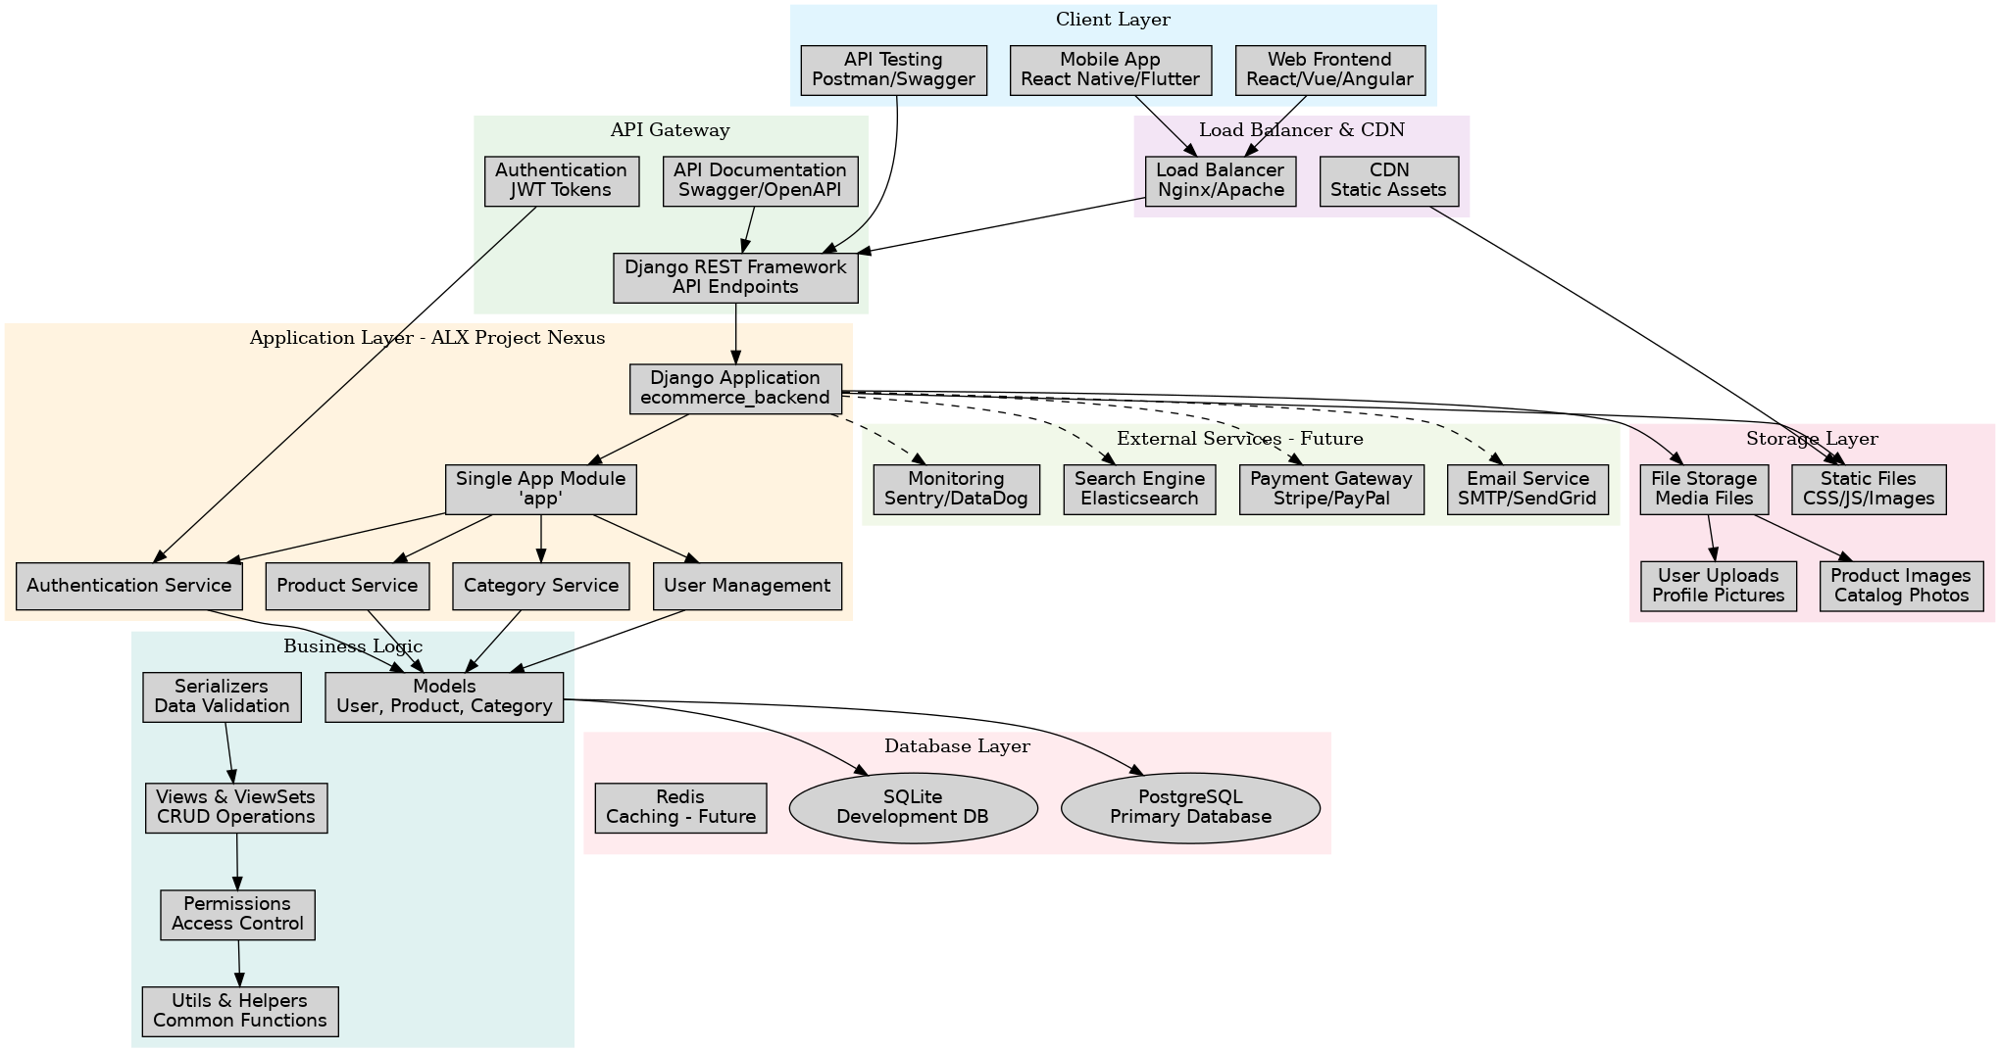
Diagrams

Slide 3
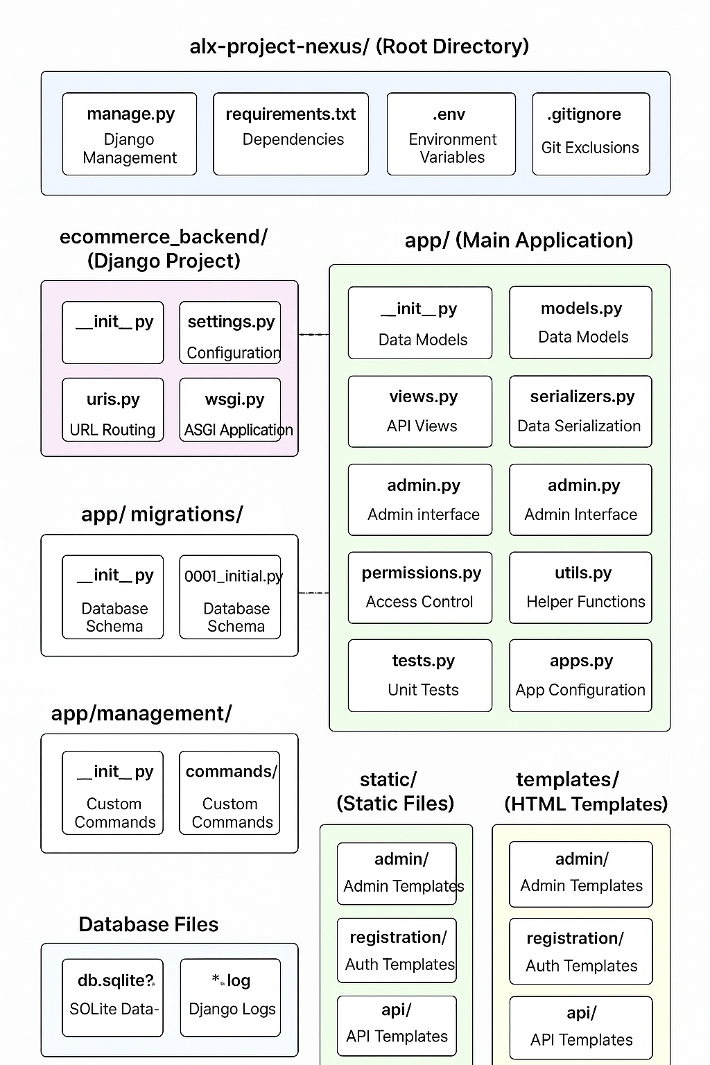
Diagrams

Slide 4
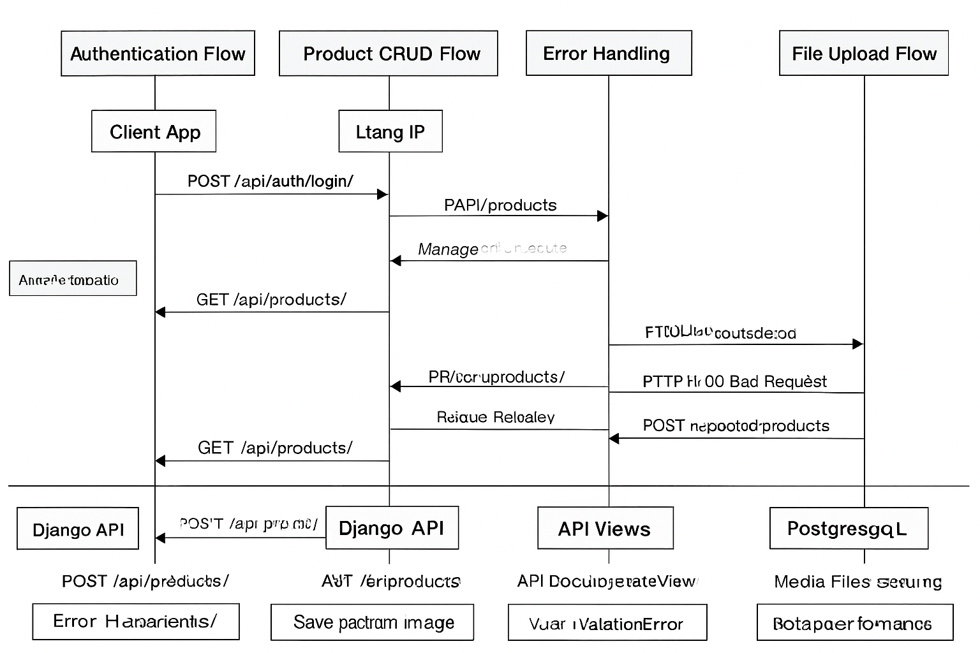
Diagrams

Slide 5
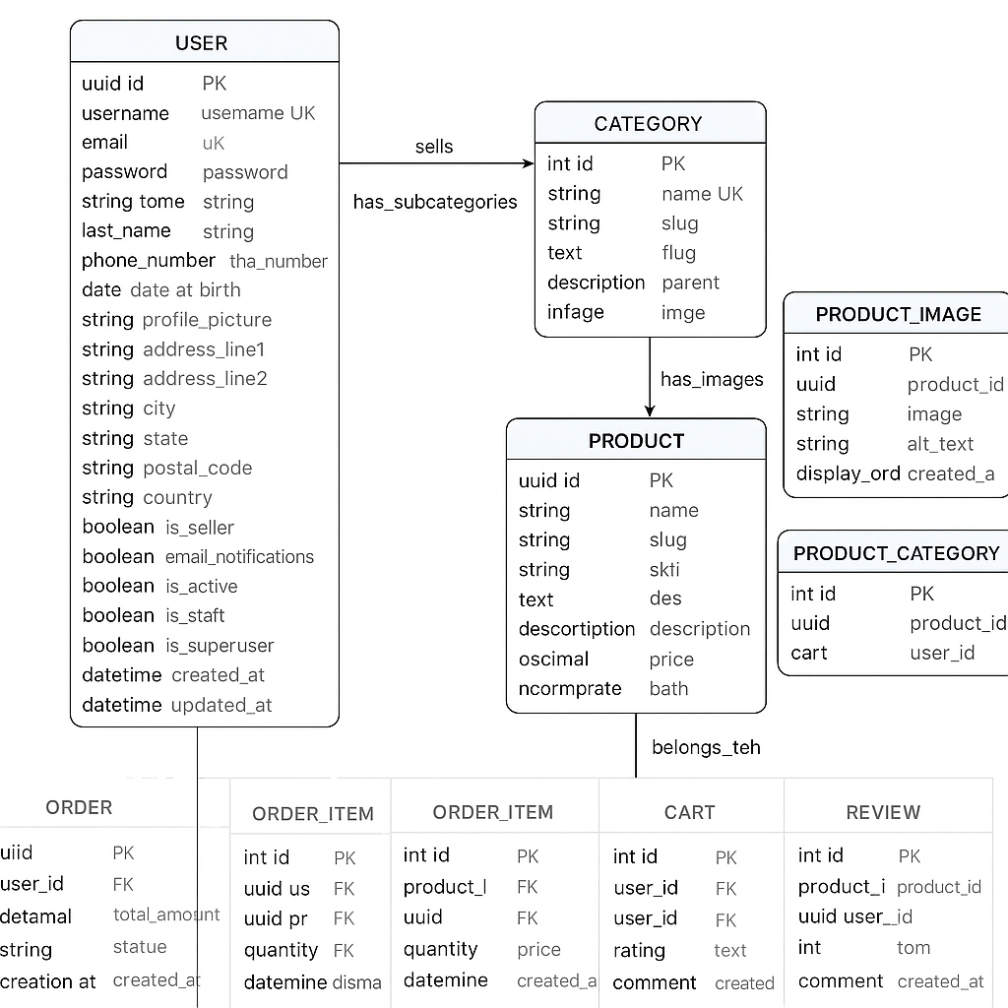
Diagrams

